Slide 1
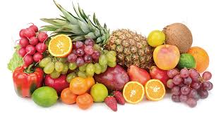
Fruit Detection
Team: The Incredibles

Slide 2
Abstract
The project is aimed at developing an AI application to predict the various types of fruits and the nutritious content present in it.

Slide 3
INTRODUCTION
Artificial Intelligence
It is the process of making machine Intelligent
Neural Networks
The Neural Network works on simulating the Human Brain

Slide 4
Types of Neural Networks
ANN
CNN
RNN

Slide 5
Convolutional Neural Network
Convolutional Neural networks are designed to process data through multiple layers of arrays.
This type of neural networks is used in applications like image recognition or face recognition.
The primary difference between CNN and any other ordinary neural network is that CNN takes input as a two-dimensional array and operates directly on the images rather than focusing on feature extraction which other neural networks focus on.

Slide 6
Convolutional neural network
CNN
Input Image
Output Label

Slide 7
Image Processing in Neural Network
pixel1
pixel2
pixel1
pixel2
B/W Image
Processing
2d Array
pixel3
pixel4
pixel3
pixel4
pixel1
pixel2
3d Array
pixel1
pixel2
Color Image
Processing
pixel3
pixel4
pixel3
pixel4

Slide 8
Steps to create CNN
Convolution
Max Pooling
Flattening
Full Connection

Slide 9
Convolution
Convolutional layers are named after the convolution operation.
In mathematics, convolution is an operation on two functions that produces
a third function that is the modified (convoluted) version of one of the original functions.
0 | 0 | 0 | 0 | 0 | 0 | 0
0 | 1 | 0 | 0 | 0 | 1 | 0
0 | 0 | 0 | 0 | 0 | 0 | 0
0 | 0 | 0 | 1 | 0 | 0 | 0
0 | 1 | 0 | 0 | 0 | 1 | 0
0 | 0 | 1 | 1 | 1 | 0 | 0
0 | 0 | 0 | 0 | 0 | 0 | 0
0 | 1 | 0 | 0 | 0
0 | 1 | 1 | 1 | 0
1 | 0 | 1 | 2 | 1
1 | 4 | 2 | 1 | 0
0 | 0 | 1 | 2 | 1
0 | 0 | 1
1 | 0 | 0
0 | 1 | 1

Slide 10
Max Pooling
Pooling layers are used on one hand to reduce the spatial dimensions of the representation and to reduce the amount of computation done in the network.
The other use of pooling layers is to control overfitting.
0 | 1 | 0 | 0 | 0
0 | 1 | 1 | 1 | 0
1 | 0 | 1 | 2 | 1
1 | 4 | 2 | 1 | 0
0 | 0 | 1 | 2 | 1
1 | 1 | 0
4 | 2 | 1
0 | 2 | 1

Slide 11
Flattening
Flatten serves as a connection between the convolution and dense layer
1
1
0
4
2
1
0
2
1
1 | 1 | 0
4 | 2 | 1
0 | 2 | 1

Slide 12
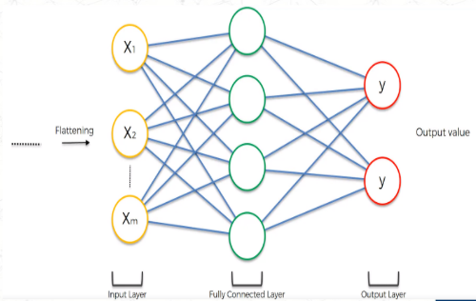
Full Connection

Slide 13
Imported libraries
numpy
keras
Sequential(keras.models)
Dense,Conv2D,MaxPooling2D,Flatten(keras.layers)

Slide 14
Activation Functions
RELU:-Stands for Rectified linear unit. It is the most widely used activation function. Chiefly implemented in hidden layers of Neural network.
SOFTMAX:-The softmax function is also a type of sigmoid function but is handy when we are trying to handle classification problems.

Slide 15
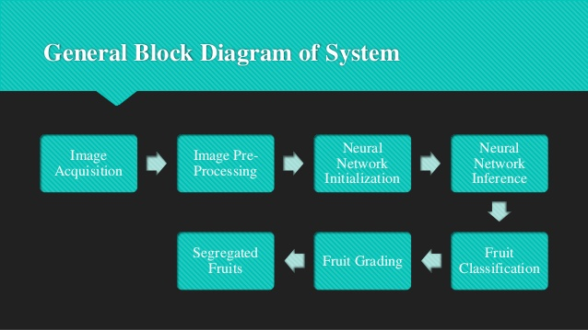
CNN Model Process for Fruit Detection

Slide 16
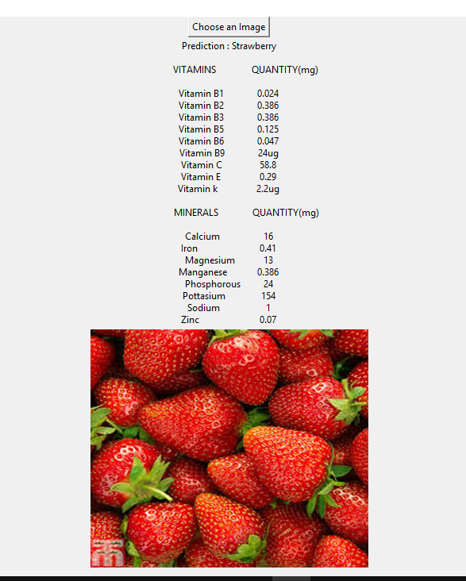
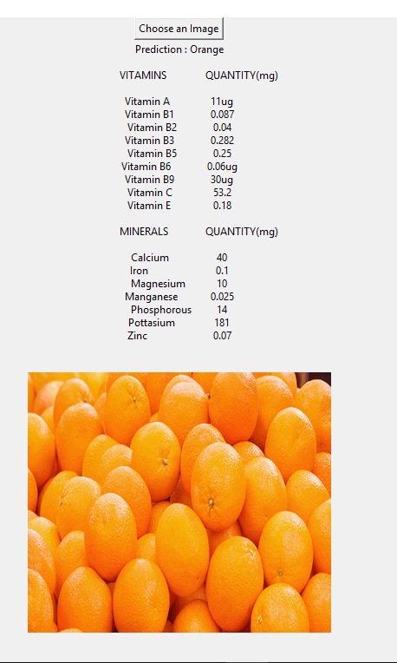
Output Screens

Slide 17


